Slide 1
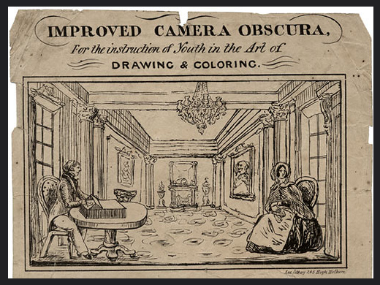
[Advertising Flyer for Improved Camera Obscura c.1819 ]
https://www.flickr.com/photos/20939975@N04/2286244518/

Slide 2
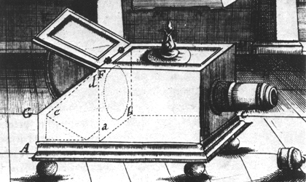
[ Johannes Zahn, 1685: Reflex Camera Obscura ]
http://www.lookandlearn.com/history-images

Slide 3
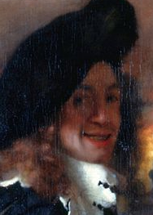
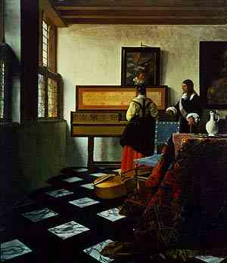
[ Netherlands, Joahannes Veermer 1632 - 1675 ]
The Music Lesson

Slide 4

[ The Music Lesson by Vermeer ]
https://www.youtube.com/watch?v=xmugrV7vM2o

Slide 5
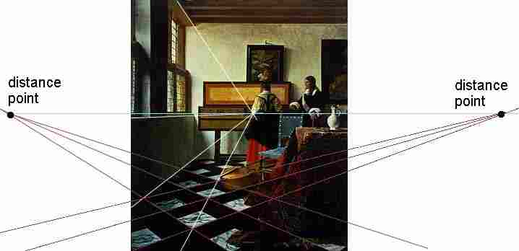
[ The Music Lesson by Vermeer ]
Perspective anlysis

Slide 6
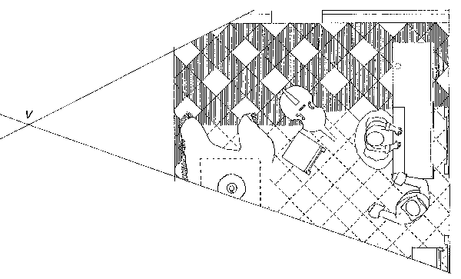
[ The Music Lesson by Vermeer ]
Top View Model

Slide 7
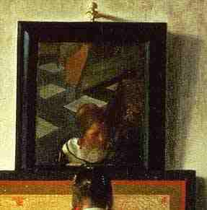
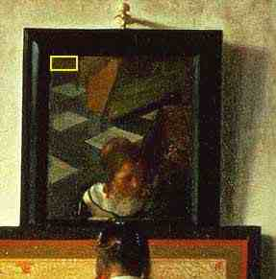
[ The Music Lesson by Vermeer ]
Perfection! on the mirror we can see the reflection of a table leg

Slide 8
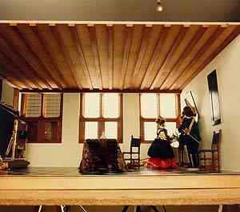
[ The Music Lesson by Vermeer ]
Reconstruction of 3D Model

Slide 9
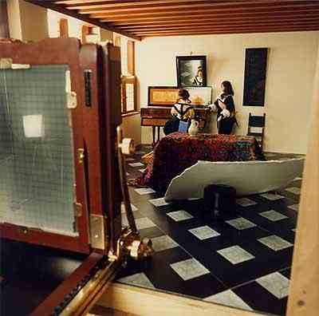
[ The Music Lesson by Vermeer ]
Photography of the 3D model

Slide 10
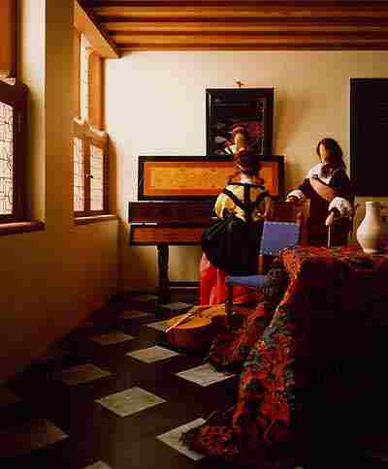
[ The Music Lesson by Vermeer ]
Photography Painting

Slide 11
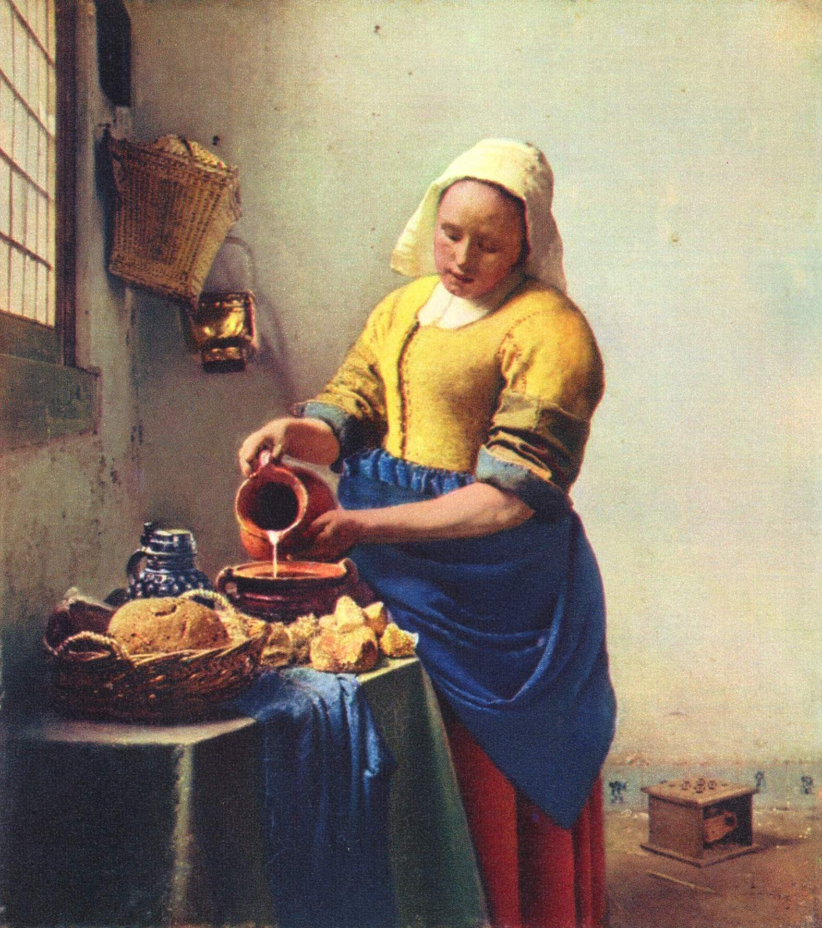
[ Historia ]
[ The Kitchen Maid by Vermeer ]
Veermer_Milk_Maid.skp

Slide 12
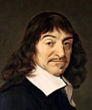
[ France, Descartes (1596 – 1650) ]
X
Y
Descartes' influence in mathematics is equally apparent; the Cartesian coordinate system — allowing reference to a point in space as a set of numbers, and allowing algebraic equations to be expressed as geometric shapes in a two-dimensional coordinate system (and conversely, shapes to be described as equations) — was named after him. He is credited as the father of analytical geometry, the bridge between algebra and geometry, crucial to the discovery of infinitesimal calculus and analysis.
(X,Y,Z)
Z
http://en.wikipedia.org/wiki/René_Descartes
Notes:
It is said (although the story is probably a myth) that Descartes came up with the idea for his coordinate system while lying in bed and watching a fly crawl on the ceiling of his room.
René Descartes was a French man who lived in the 1600s. When he was a child, he was often sick, so the teachers at his boarding school let him stay in bed until noon. He went on staying in bed until noon for almost all his life. While in bed, Descartes thought about math and philosophy.
One day, Descartes noticed a fly crawling around on the ceiling. He watched the fly for a long time. He wanted to know how to tell someone else where the fly was. Finally he realized that he could describe the position of the fly by its distance from the walls of the room. When he got out of bed, Descartes wrote down what he had discovered. Then he tried describing the positions of points, the same way he described the position of the fly. Descartes had invented thecoordinate plane! In fact, the coordinate plane is sometimes called the Cartesian plane, in his honor.
http://mathforum.org/cgraph/history/fly.html

Slide 13
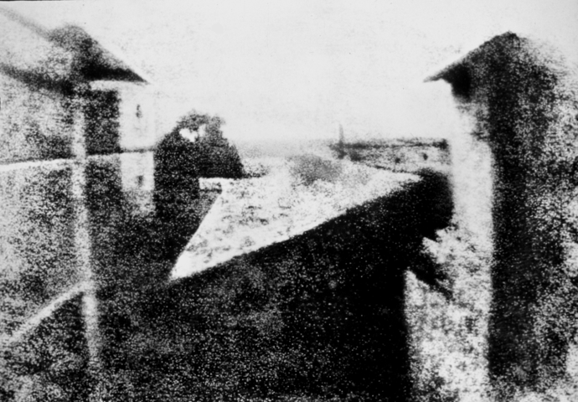
[ Nicéphore Niépce, France, 1826 ]
The first photography: View from the Window at Le Gras
(Saint-Loup-de-Varennes, France)
http://en.wikipedia.org/wiki/History_of_photography

Slide 14
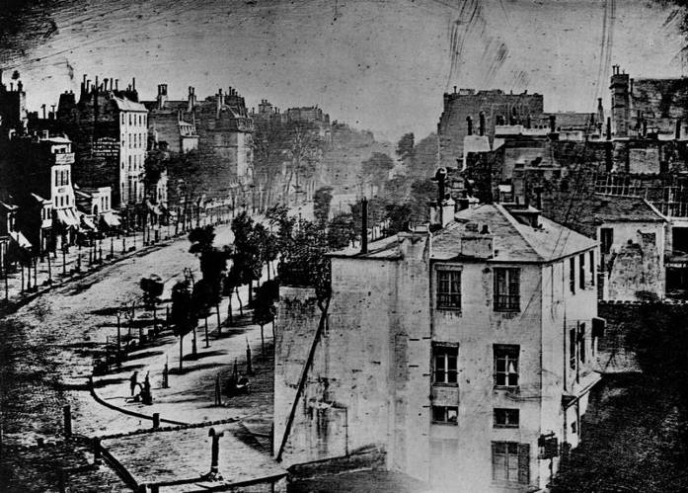
[ Louis Daguere, France, 1838 ]
Boulevard du Temple
http://en.wikipedia.org/wiki/History_of_photography

Slide 15
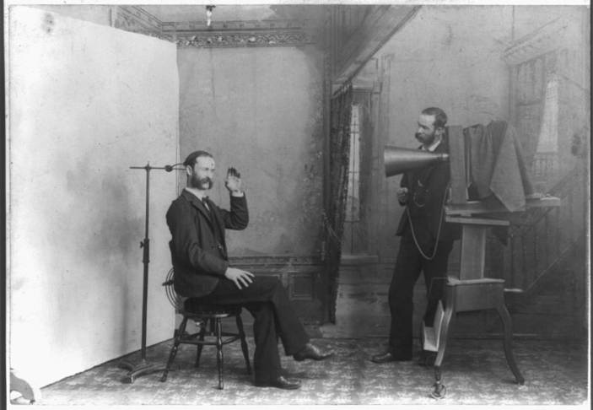
[ Photographic Studio, 19th century ]
http://en.wikipedia.org/wiki/History_of_photography

Slide 16
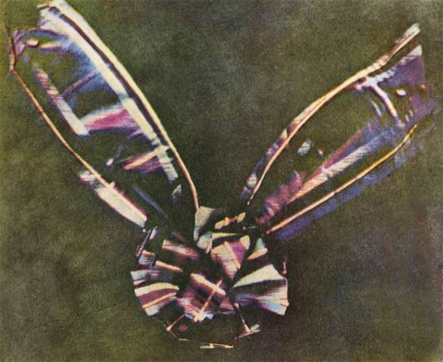
[ Thomas Suton, England, 1861 ]
First color photograph using a reflex camera
http://en.wikipedia.org/wiki/History_of_photography

Slide 17
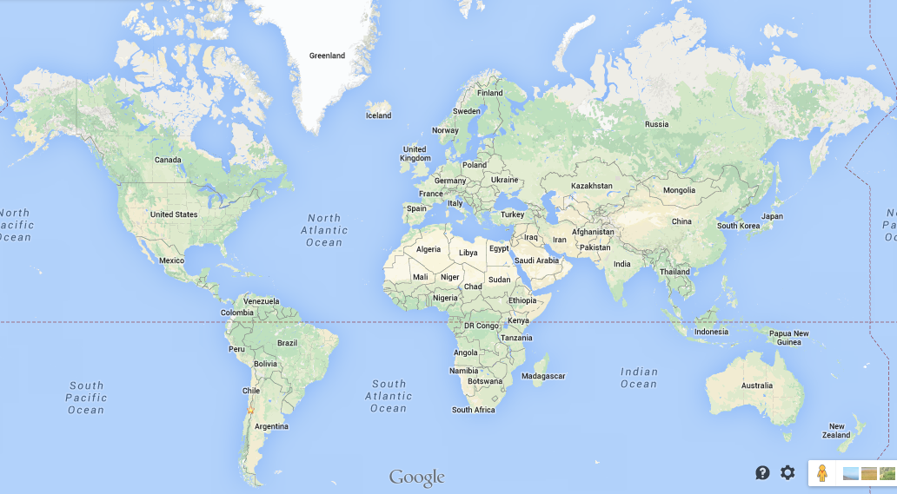
20th century

Slide 18
[ 1920: Digital transmission of images for newspapers ]
Gonzalez et al (2009): Digital Image Processing Using Matlab, 2nd Edition, Gatesmark Publishing.

Slide 19
[ 1964: First picture of the moon ]
Gonzalez et al (2009): Digital Image Processing Using Matlab, 2nd Edition, Gatesmark Publishing.

Slide 20
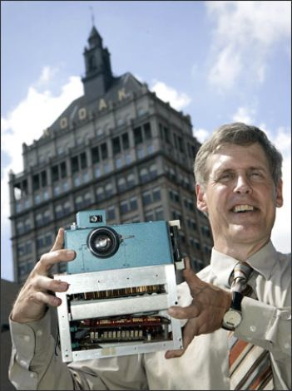
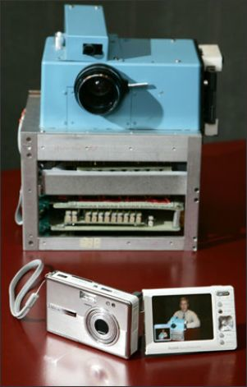
[ 1975, Steve Sasson, inventor of the first digital camera ]
It weighed 8 pounds (3.6 kg)
It had only 100x100 Pixels 0.01 Mega Pixels.
The image was recorded onto a cassette tape and this process took 23 seconds.
It took images in black and white.
http://en.wikipedia.org/wiki/Steven_Sasson
http://www.seattlepi.com/business/article/Kodak-engineer-had-revolutionary-idea-the-first-1182624.php

Slide 21
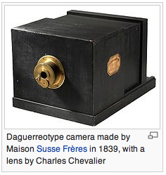
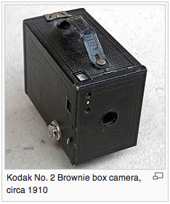
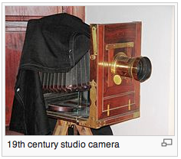
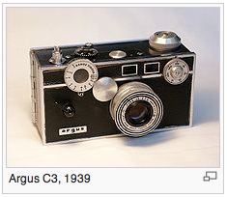
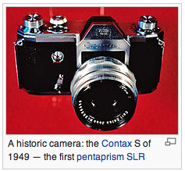
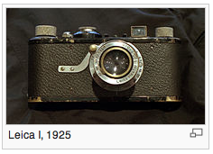
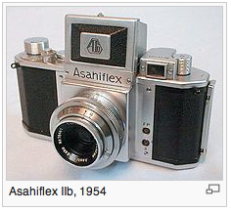
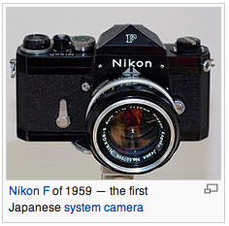
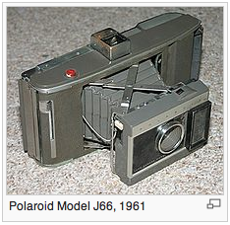
[ Evolution of the camera ]
http://en.wikipedia.org/wiki/History_of_the_camera

Slide 22
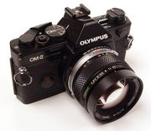
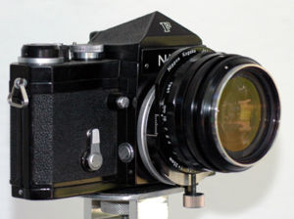
[ 1960 – 1970 Single Lens Reflex Camera ]
http://en.wikipedia.org/wiki/History_of_the_camera

Slide 23
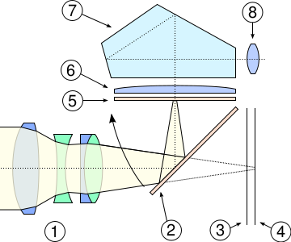
[ Single lens reflex camera ]
Cross-section view of SLR system: 1) Lens 2) Mirror 3) Shutter 4) Film or sensor 5) Focusing screen 6) Condensing lens 7) Pentaprism 8) Eyepiece
http://en.wikipedia.org/wiki/History_of_the_camera

Slide 24
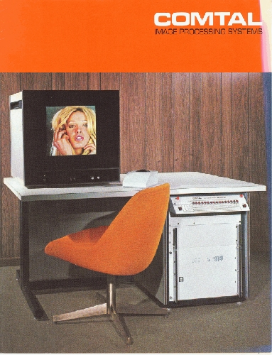
[ Image Processing Software (1974): 512 x 512 pixels ]
http://www.computerhistory.org/collections/accession/102646321

Slide 25
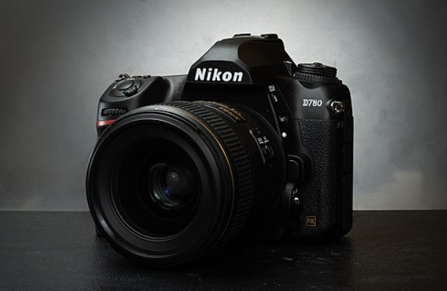
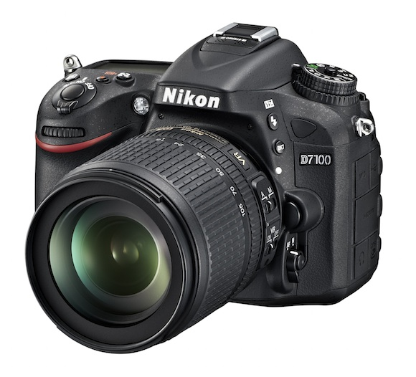
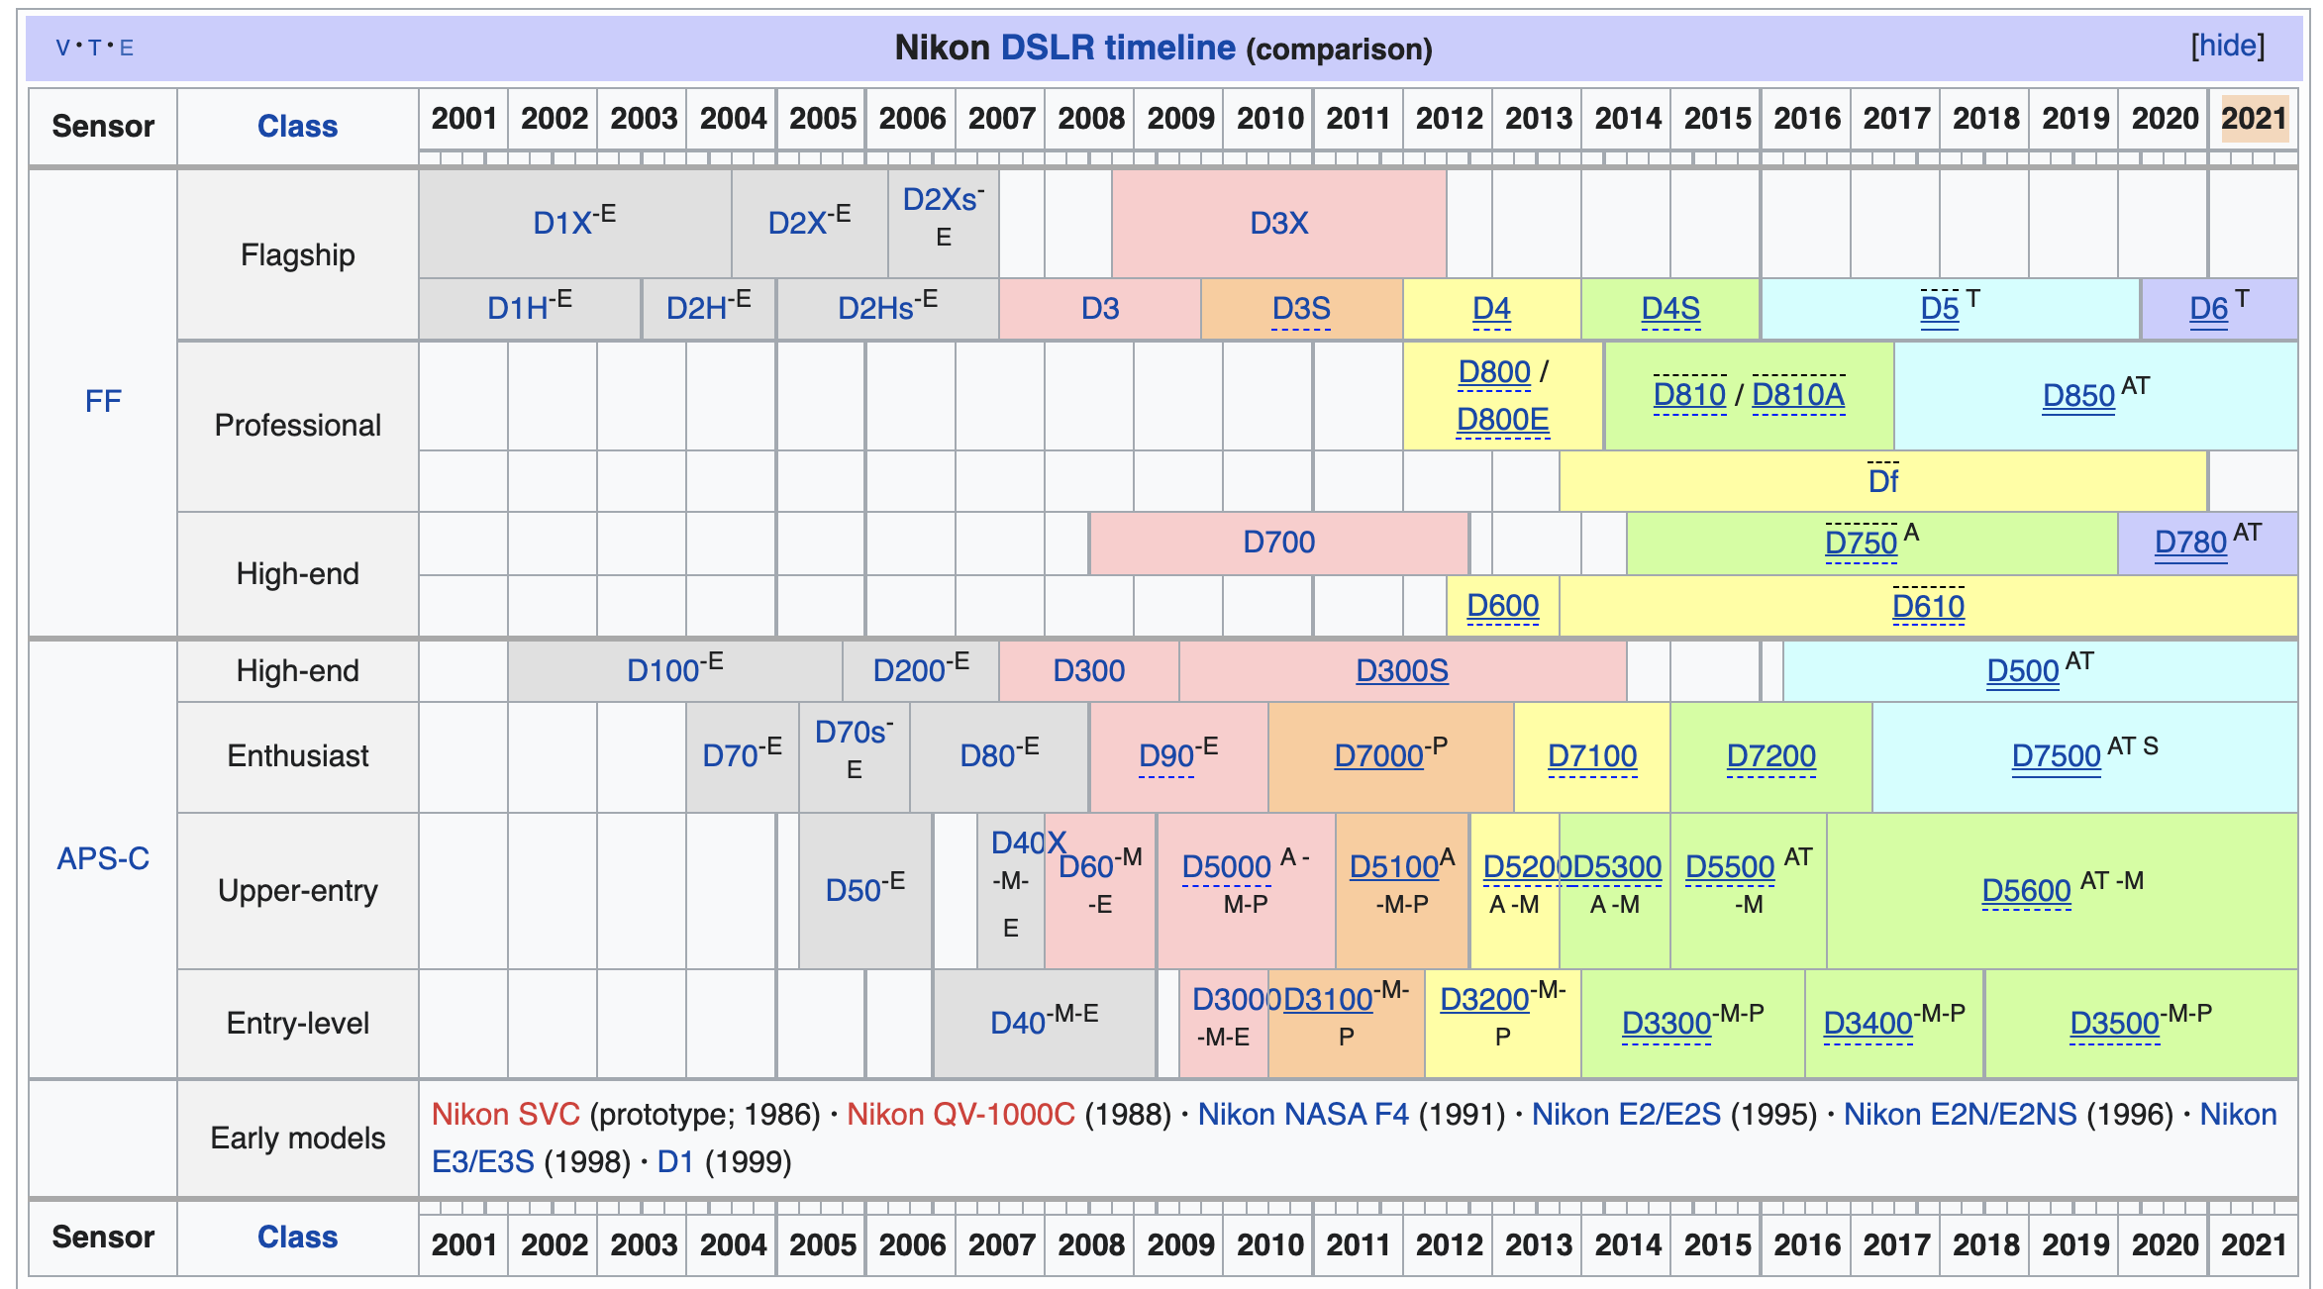
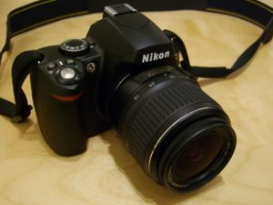
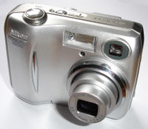
[ Evolution of Nikon Cameras ]
https://en.wikipedia.org/wiki/Nikon

Slide 26
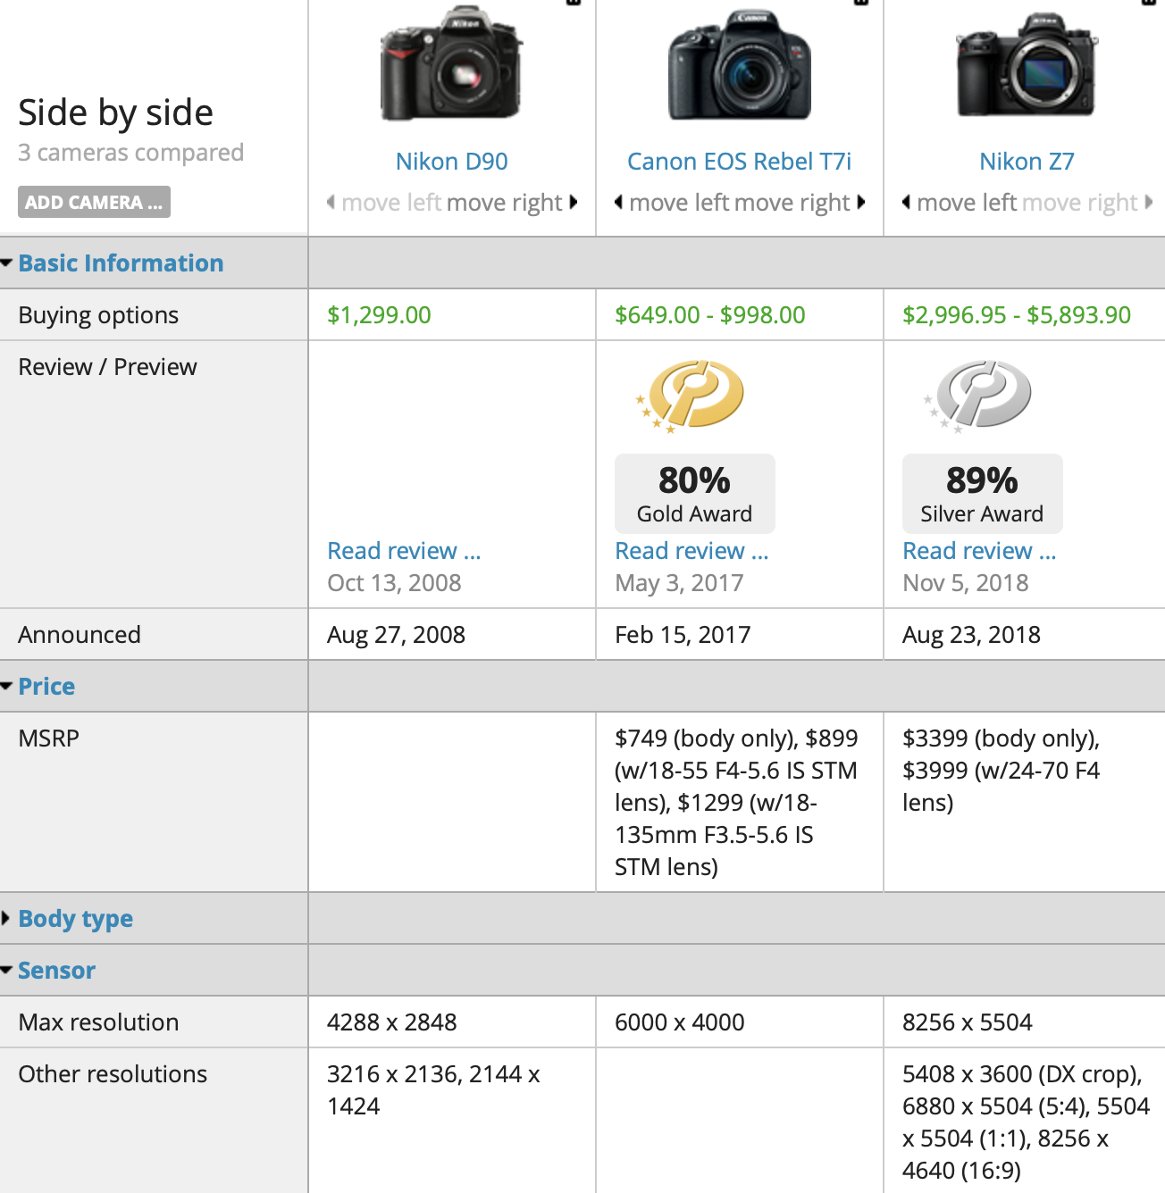
[ Cameras - Today ]
http://www.dpreview.com/products/compare/cameras

Slide 27
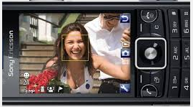
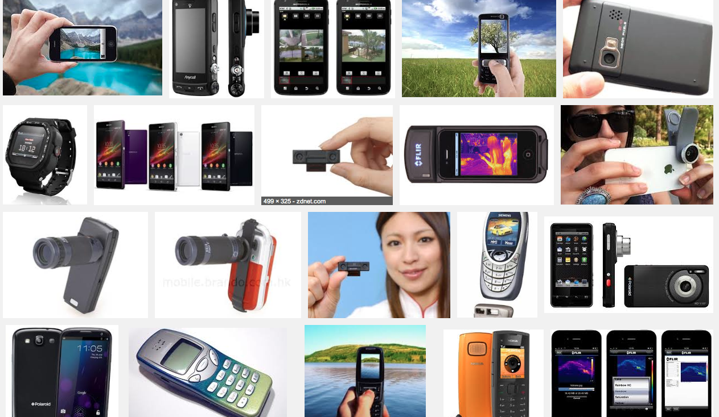
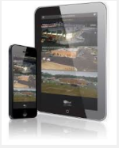
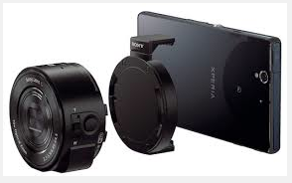
[ Mobile Devices - Today ]
Google Images

Slide 28
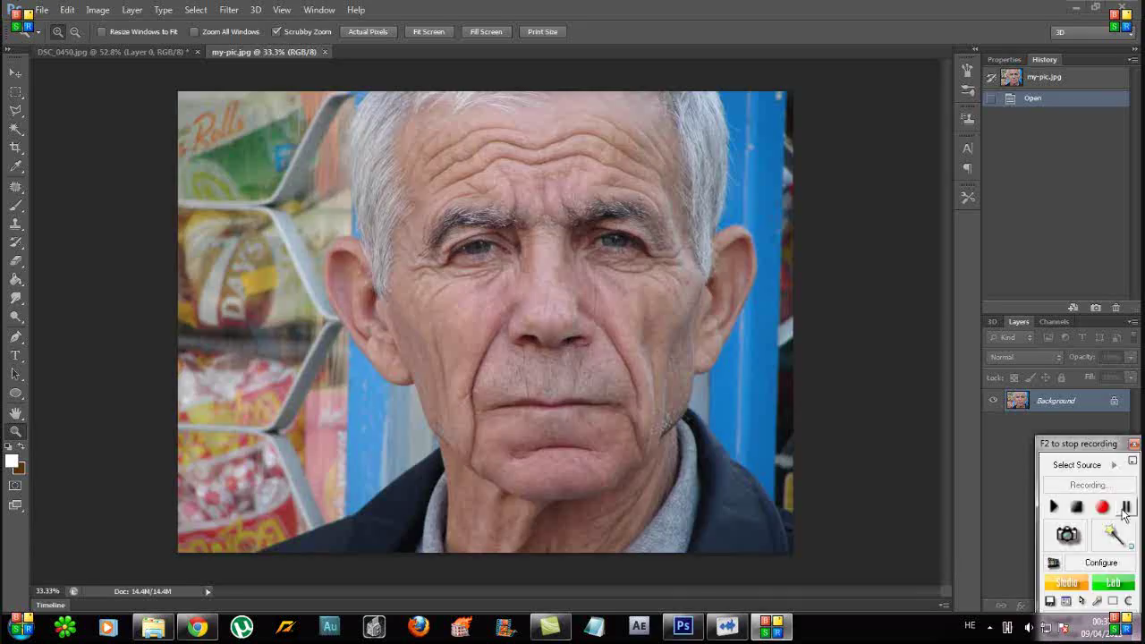
[ Software - Today ]
https://www.youtube.com/watch?v=FcFPzwl5WH8

